Slide 1
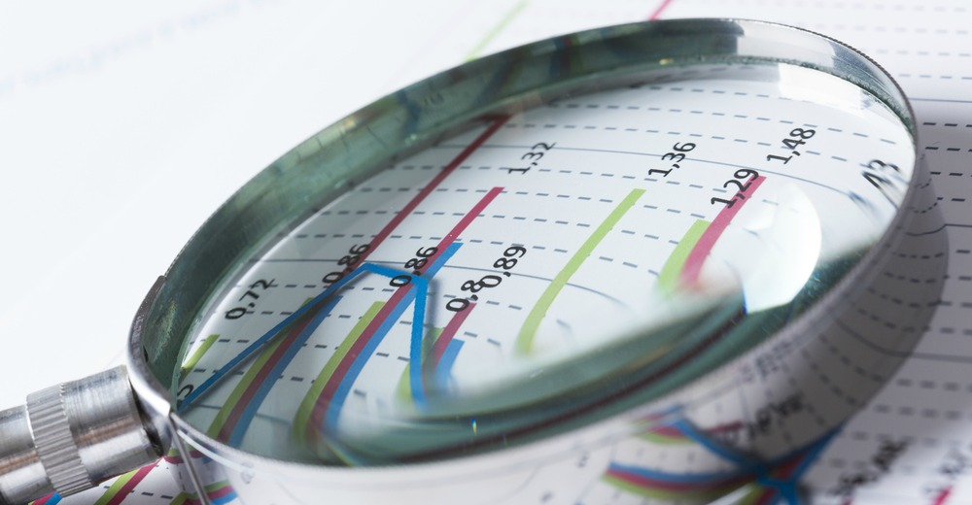
Data Analytics Process Application in Real Life Scenario (Case Study)
By Stan John Pereira

Slide 2
Data Analytics
"Data Analytics is the science of analyzing raw data to make conclusions about that information. It involves using various tools and methods to identify patterns, trends, and relationships within the data that can help organizations make informed decisions and improve their operations."
Simply put, Data Analytics is the process of drawing conclusions about information after examining the available raw data.
Data Analytics is used in everyday life, even though we do not realize it. A couple of scenarios would be Shopping Patterns, Cell Phone Usage Patterns, Social Media Statistics, Child's Marks Progress

Slide 3
Case Study
The case study that we are going to be presenting is an example of a real-life scenario where we use Data Analytics.
"Placing an order for Food via Delivery"
We will use the data analytics process to further explain the scenario. The various steps of this process are :
Plan
Prepare
Process
Analyze
Share
Act

Slide 4
Explaining the Scenario
Placing a Food Order to be delivered to you at a specified location, is something many people can relate to as it is a scenario that they have faced multiple times.
The decision made to place an order includes raw data, analysis, interpretation and final conclusion/decision.
The case study uses the various data points needed to place a food order using the delivery method to finally result in a satisfiable outcome.

Slide 5
Data Analytics Steps
Plan
The first step in the Data Analytics process is to 'Plan'. The planning process includes collection of various data points and data.
Some of the data points used in our scenario are:
Mode of Ordering – Online/Phone
Food Type(Indian/Chinese/Thai)
Restaurant Selection based on Distance, Reviews, Price
Menu Selection (Starters, Soups, Main Course, Desserts)
Portion Size
Likes/Dislikes

Slide 6
Data Analytics Steps
Prepare
The 'Prepare' step includes data that is needed to complete the process.
Some of the data points used in our scenario are:
Finance Options Available – Cash on Delivery, Credit Card, UPI etc.
Contact Details – Phone Number/Food App
Restaurant Availability – Open / Closed
Food Availability

Slide 7
Data Analytics Steps
Process
This step allows you to prepare the best way to go ahead using the data collected in the above two steps.
Analyze
The 'Analyze' step allows for us to methodically think and interpretate the data collected to explain the relationships. Some of the analysis interpretations in this scenario are:
You will try to stay within the Budget allotted for the order
The Food Quantity will not be less than the required amount
Comparison of Reviews for Food you like in various restaurants
Restaurant Reviews

Slide 8
Data Analytics Steps
Share
The 'Share' step enables you to share the information to attain insights on the data collected and analysis done. This can also help get further information/data necessary.
In this scenario, you can communicate with the restaurant/food app the order and get further options such as any offers based on amount, items ordered, payment options etc.
Act
The 'Act' step is the final step which is the act of placing the order, accepting the delivery, paying the order and finally enjoying the meal.

Slide 9
Conclusion
Data Analytics plays an important role in our day-to-day lives. It helps us make crucial and informed decisions in a variety of ways.
Data Analytics also helps us to gain valuable insights from massive data. The analysis of this data, helps us identify trends, predict outcomes and optimize processes
In conclusion, data analytics is a powerful utility that will help drive innovation and growth in all fields, whether it is customer support or production efficiency.
Effective use of the Data Analytics process allows for extracting better insights and conclusions.

Slide 10
THANK YOU!!

